Slide 1


ELECTRIC TRAINING CENTRE
GHAZIABAD
SPEEDOMETER DATA ANALYSIS
DELHI DIVISION

Slide 2
CASE STUDY-1

Slide 3
SPEEDOMETER DATA ANALYSIS-1
Journey Date: 16.12.24
LP Name/Desig:
Train No. PWHR-DMSJ (GOODS/L (CONV))
Remarks:
Report ID: 171224/07377
ALP Name:
Loco Number: 43444/SBTD
Section: SSB-GZB MEDHA
MPS attained: 50 kmph | Average Speed: 11.62 kmph
Total Distance: 48.74 km | Total Time: 4:11:35
Distance covered at near MPS: -- (speed>.95xMPS) | Time Range of Analysis: 8:09:15 AM - 12:20:56 PM
Late Controlling: YES Over Speeding: NO Improper BPT: NO | Abrupt Braking: NO Poor Running: -- SR Overspeed: NO
BPT @ 8:12:41 AM | SPEED DROP: 29 - 10 | BFT @ -- | SPEED DROP: - -
SPEED WHILE APPROACHING STOP SIGNAL AT DANGER
SGNL | TIME/KM NO | SPEED B4 1000mtr | SPEED B4 500mtr | SPEED B4 100mtr | SPEED B4 10mtr | Speed at Controlling/ Braking Distance | BRAKING Technique
-- | 8:18:48 AM | 30 | 11 | 6 | 4 | 30kmph / 0.907 km | Smooth
-- | 8:38:27 AM | 14 | 14 | 11 | 3 | 16kmph / 1.812 km | Smooth
-- | 9:10:28 AM | 22 | 12 | 13 | 5 | 18kmph / 0.576 km | Smooth
-- | 9:16:59 AM | 13 | 9 | 9 | 5 | 10kmph / 0.78 km | Smooth
-- | 9:34:45 AM | 18 | 13 | 10 | 7 | 16kmph / 0.58 km | Smooth
-- | 9:40:11 AM | 18 | 11 | 7 | 6 | 7kmph / 0.108 km | Smooth
-- | 10:01:06 AM | 10 | 11 | 8 | 4 | 7kmph / 1.322 km | Smooth
-- | 10:20:37 AM | 11 | 12 | 7 | 5 | 5kmph / 0.142 km | Smooth
-- | 10:42:54 AM | 18 | 17 | 11 | 3 | 13kmph / 4.067 km | Smooth
-- | 11:18:00 AM | 34 | 22 | 8 | 8 | 47kmph / 2.007 km | Late
-- | 11:46:43 AM | 5 | 12 | 9 | 6 | 10kmph / 0.853 km | Smooth
-- | 12:05:25 PM | 12 | 10 | 7 | 3 | 15kmph / 1.616 km | Smooth

Slide 4
LP PERFORMANCE REPORT
-- | 12:12:04 PM | 10 | 4 | 7 | 5 | 6kmph / 0.412 km | Smooth
-- | 12:20:58 PM | 7 | 5 | 6 | 1 | 6kmph / 1.046 km | Smooth
SPEED RESTRICTIONS OBSERVED BY THE LP
Section | SR Specified Speed | START FROM | END AT | AVG Speed Observed | Distance Travelled
-- | -- | -- | -- | ** | **
Analysis report as under
1. Late Controlling- 1 case speed 34Km/Ph so LP has counseled on yellow aspect Speed should not more than 30 Km/Ph
Over Speeding- No
Improper BPT-No
4.Abrupt Breaking -No
5.S R Over speeding-No
Report checked by
Ravindra Kumar CLI Gzb17/12/2024

Slide 5
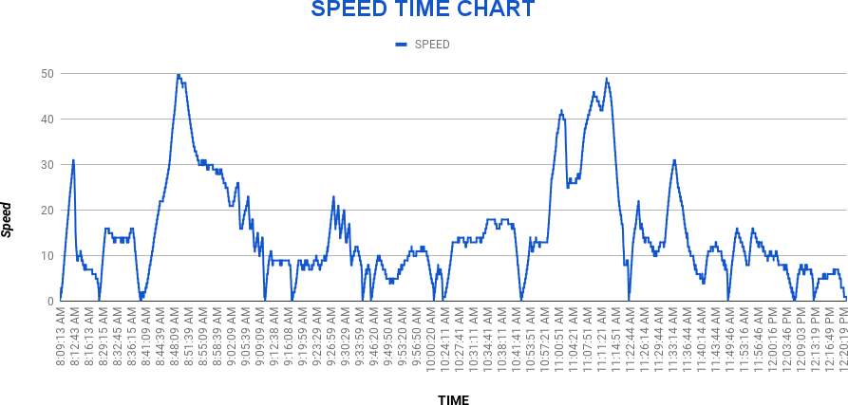
LP PERFORMANCE REPORT
Indian Railways
SPM Analysis

Slide 6
CASE STUDY-2

Slide 7
SPEEDOMETER DATA ANALYSIS-2
Journey Date: 16.12.24
LP Name/Desig:
Train No. 12555 (CHG)
Remarks:
Report ID: 171224/07763
ALP Name:
Loco Number: 30485/TKD
Section: CNB-NDLS TELPRO
MPS attained: 130 kmph | Average Speed: 77.5 kmph
Total Distance: 441.27 km | Total Time: 5:41:38
Distance covered at near MPS: 187.27 km (speed>.95xMPS) | Time Range of Analysis: 11:43:12 PM - 5:24:56 AM
Late Controlling: NO Over Speeding: NO Improper BPT: NO | Abrupt Braking: NO Poor Running: NO SR Overspeed: NO
BPT @ 11:54:53 PM | SPEED DROP: 58 - 29 | BFT @ 11:44:04 PM | SPEED DROP: 9 - 5
SPEED WHILE APPROACHING STOP SIGNAL AT DANGER
SGNL | TIME/KM NO | SPEED B4 1000mtr | SPEED B4 500mtr | SPEED B4 100mtr | SPEED B4 10mtr | Speed at Controlling/ Braking Distance | BRAKING Technique
-- | 4:36:33 AM | 18 | 14 | 14 | 7 | 27kmph / 2.317 km | Smooth
-- | 5:21:45 AM | 30 | 15 | 10 | 2 | 43kmph / 3.103 km | Smooth
SPEED RESTRICTIONS OBSERVED BY THE LP
Section | SR Specified Speed | START FROM | END AT | AVG Speed Observed | Distance Travelled
-- | -- | -- | -- | ** | **
Analysis report as under
Late Controlling- No
Over Speeding-Noo
Improper BPT-N
Report checked by
Ravindra Kumar CLI,Gzb 17/12/2024
Abrupt Breaking -No
S R Over speeding-No
Indian Railways
SPM Analysis

Slide 8
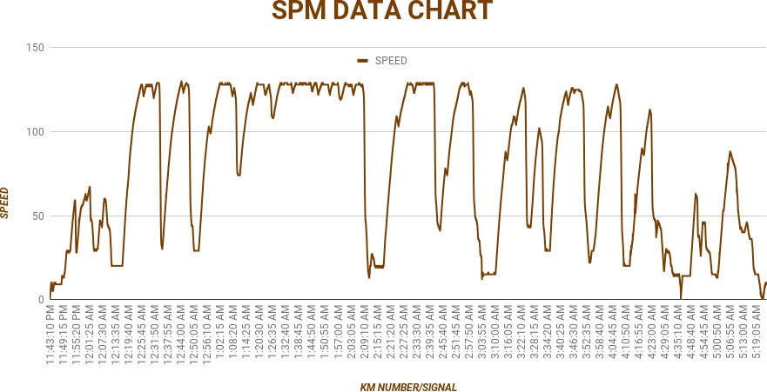
NO deficiency found ✔
Indian Railways
SPM Analysis

Slide 9
CASE STUDY-3

Slide 10
SPEEDOMETER DATA ANALYSIS-3
Journey Date: 14.12.24
LP Name/Desig:
Train No. BVH (GOODS/E (CONV))
Remarks:
Report ID: 151224/03879
ALP Name:
Loco Number: 32833/PTRU
Section: GZB-TKD LAXVEN
MPS attained: 57 kmph | Average Speed: 10.33 kmph
Total Distance: 33.46 km | Total Time: 3:14:17
Distance covered at near MPS: 0.16 km (speed>.95xMPS) | Time Range of Analysis: 10:14:51 PM - 1:29:14 AM
Late Controlling: NO Over Speeding: NO Improper BPT: YES | Abrupt Braking: NO Poor Running: YES SR Overspeed: NO
Analysis report as under
Late Controlling- No
Over Speeding-No
Improper BPT-No Abrupt
Abrupt Breaking -No
S R Over speeding-No
Breaking -No
S R Over speeding-No
BPT @ 10:28:05 PM | SPEED DROP: 40 - 7 | BFT @ 10:17:38 PM | SPEED DROP: 10 - 2
SPEED WHILE APPROACHING STOP SIGNAL AT DANGER
SGNL | TIME/KM NO | SPEED B4 1000mtr | SPEED B4 500mtr | SPEED B4 100mtr | SPEED B4 10mtr | Speed at Controlling/ Braking Distance | BRAKING Technique
-- | 10:18:13 PM | -- | -- | 8 | 5 | 16kmph / 1.381 km | Smooth
-- | 10:37:15 PM | 19 | 17 | 8 | 7 | 15kmph / 4.814 km | Smooth
-- | 11:44:10 PM | 13 | 14 | 10 | 4 | 15kmph / 7.048 km | Smooth
-- | 12:09:15 AM | 13 | 13 | 4 | 2 | 15kmph / 8.752 km | Smooth
-- | 12:41:58 AM | 13 | 14 | 4 | 4 | 14kmph / 0.922 km | Smooth
-- | 12:50:41 AM | 12 | 12 | 8 | 4 | 12kmph / 2.933 km | Smooth
-- | 1:15:01 AM | 10 | 10 | 6 | 2 | -- | --
Report checked by
Ravindra Kumar CLI Gzb 2417/12/20
SPEED RESTRICTIONS OBSERVED BY THE LP
Section | SR Specified Speed | START FROM | END AT | AVG Speed Observed | Distance Travelled
-- | -- | -- | -- | ** | **

Slide 11
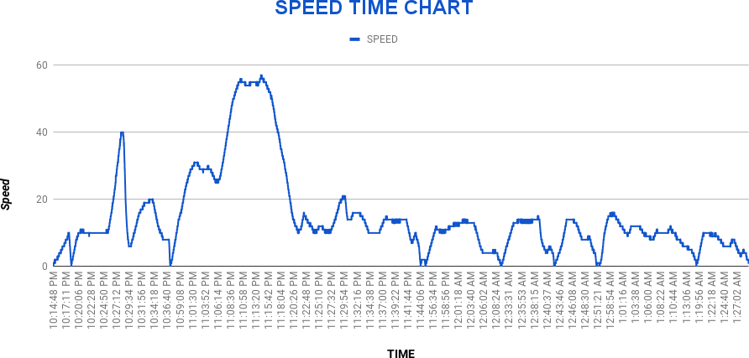
LP PERFORMANCE REPORT
Indian Railways
SPM Analysis

Slide 12
CASE STUDY-4

Slide 13
SPEEDOMETER DATA ANALYSIS- 4
WAKDIKA PG/JIND
Train No. 04991 (LCHG)
Remarks: Load 07 Coaches
Report ID: 061224/15109
ALP Name:
Loco Number: 22275/JHS
Section: KKDE-JIND Telpro
LP Name/Desig:
Journey Date: 06.12.2024
MPS attained: 100 kmph | Average Speed: 32.52 kmph
Total Distance: 120.59 km | Total Time: 3:42:28
Distance covered at near MPS: 33.04 km (speed>.95xMPS) | Time Range of Analysis: 7:53:16 AM - 11:35:40 AM
Late Controlling: YES Over Speeding: NO Improper BPT: NO | Abrupt Braking: YES Poor Running: NO SR Overspeed: NO
BPT @ 8:01:31 AM | SPEED DROP: 48 - 22 | BFT @ 7:53:30 AM | SPEED DROP: 5 - 4
SPEED WHILE APPROACHING STOP SIGNAL AT DANGER
SGNL | TIME/KM NO | SPEED B4 1000mtr | SPEED B4 500mtr | SPEED B4 100mtr | SPEED B4 10mtr | Speed at Controlling/ Braking Distance | BRAKING Technique
-- | 1345.446 | 27 | 45 | 25 | 13 | 44kmph / 0.455 km | Late
-- | 1332.561 | 75 | 39 | 30 | 12 | 94kmph / 2.785 km | Late
-- | 1327.767 | 91 | 54 | 31 | 11 | 94kmph / 1.897 km | Late
-- | 1323.578 | 53 | 24 | 24 | 12 | 26kmph / 0.361 km | Late
-- | 1313.742 | 84 | 51 | 27 | 10 | 93kmph / 1.467 km | Abrupt
-- | 1307.085 | 51 | 50 | 28 | 10 | 99kmph / 2.861 km | Late
-- | 1302.055 | 51 | 49 | 28 | 13 | 94kmph / 2.527 km | Late
-- | 1299.639 | 49 | 27 | 26 | 11 | 27kmph / 0.421 km | Late
-- | 1293.503 | 76 | 51 | 26 | 14 | 91kmph / 3.23 km | Late
-- | 1287.21 | 47 | 45 | 29 | 7 | 97kmph / 2.555 km | Late
-- | 1278.807 | 50 | 44 | 28 | 12 | 93kmph / 2.603 km | Late
-- | 1270.466 | 83 | 44 | 23 | 14 | 96kmph / 2.943 km | Late
Indian Railways
SPM Analysis

Slide 14
-- | 1263.534 | 47 | 44 | 16 | 10 | 98kmph / 3.372 km | Late
-- | 1262.237 | 13 | 10 | 22 | 9 | 23kmph / 0.168 km | Smooth
-- | 1254.976 | 48 | 26 | 27 | 11 | 99kmph / 2.788 km | Late
-- | 1247.012 | 50 | 28 | 28 | 14 | -- | --
-- | 1236.32 | 47 | 28 | 27 | 12 | -- | --
-- | 1229.945 | 48 | 46 | 17 | 9 | -- | --
-- | 1228.414 | 35 | 25 | 25 | 13 | -- | --
SPEED RESTRICTIONS OBSERVED BY THE LP
Section | SR Specified Speed | START FROM | END AT | AVG Speed Observed | Distance Travelled
-- | -- | -- | -- | ** | **
Report:-
Late controlling 13 Times but timimg not showing in graph Abrupt Braking
1 Time -------------do------------------------
but LP warned and counselle
Report
checked by
sanjeev Mohan CLI/JHL

Slide 15
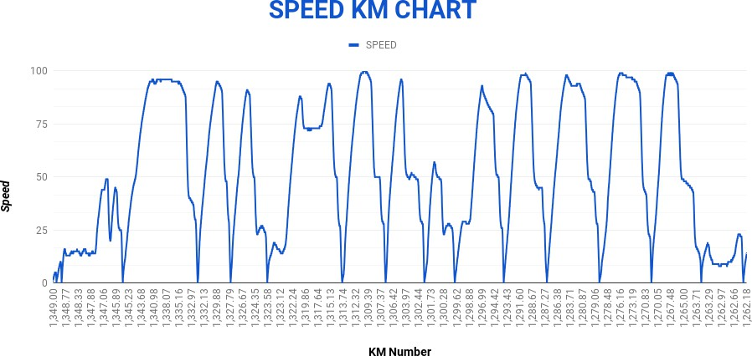
LP PERFORMANCE REPORT

Slide 16
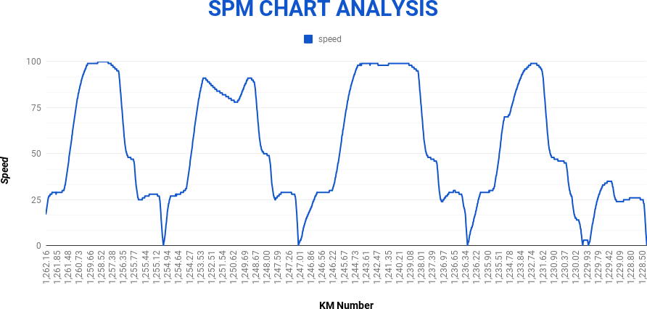
LP PERFORMANCE REPORT

Slide 17
CASE STUDY-5

Slide 18
SPEEDOMETER DATA ANALYSIS-5
Journey Date: 11.12.24
LP Name/Desig:
Train No. 04978 (CHG)
Remarks:
Report ID: 111224/1743
ALP Name:
Loco Number: 32432/TKD
Section: BNW-ROK TELPRO
MPS attained: 99 kmph | Average Speed: 31.8 kmph
Total Distance: 49.61 km | Total Time: 1:33:35
Distance covered at near MPS: 11.65 km (speed>.95xMPS) | Time Range of Analysis: 7:52:29 AM - 9:26:10 AM
Late Controlling: YES Over Speeding: NO Improper BPT: NO | Abrupt Braking: YES Poor Running: NO SR Overspeed: NO
BPT @ 7:57:40 AM | SPEED DROP: 52 - 24 | BFT @ 7:53:03 AM | SPEED DROP: 11 - 4
SPEED WHILE APPROACHING STOP SIGNAL AT DANGER
SGNL | TIME/KM NO | SPEED B4 1000mtr | SPEED B4 500mtr | SPEED B4 100mtr | SPEED B4 10mtr | Speed at Controlling/ Braking Distance | BRAKING Technique
-- | 8:04:46 AM | 47 | 14 | 14 | 10 | 63kmph / 1.475 km | Late
-- | 8:17:41 AM | 48 | 28 | 26 | 11 | 97kmph / 2.09 km | Late
-- | 8:26:00 AM | 97 | 86 | 36 | 12 | 97kmph / 1.237 km | Abrupt
-- | 8:35:06 AM | 47 | 26 | 22 | 12 | 93kmph / 2.599 km | Late
-- | 8:46:06 AM | 38 | 25 | 26 | 10 | 97kmph / 2.833 km | Late
-- | 8:55:10 AM | 31 | 37 | 34 | 8 | 38kmph / 0.762 km | Late
-- | 9:00:48 AM | 35 | 13 | 13 | 10 | 42kmph / 1.114 km | Late
-- | 9:20:49 AM | 40 | 30 | 18 | 4 | 68kmph / 2.013 km | Late
-- | 9:26:14 AM | 27 | 27 | 22 | 8 | 28kmph / 1.235 km | Smooth
SPEED RESTRICTIONS OBSERVED BY THE LP
Section | SR Specified Speed | START FROM | END AT | AVG Speed Observed | Distance Travelled
Report Analysis
Late controlling (Yes/7 times) but speed found under 50 kmph as per rule
Abrupt braking (yes) as per crew note book in was stopage at hault
LP counselled regarding reduce speed less than 50 kmph on hault board checked by –cli-sanjeev mohan/mtc

Slide 19
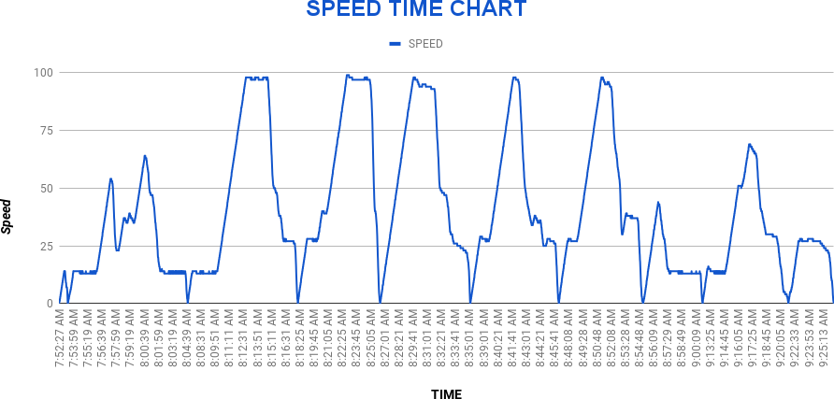
Indian Railways
SPM Analysis

Slide 20
CASE STUDY-6

Slide 21
SPEEDOMETER DATA ANALYSIS-6
Journey Date: 10.12.24
LP Name/Desig:
Train No. E BOX (GOODS/E (CONV))
Remarks:
Report ID: 111224/00997
ALP Name:
Loco Number: 23445/NKJ
Section: JHI-SSB TELPRO
MPS attained: 74 kmph | Average Speed: 37.03 kmph
Total Distance: 117.35 km | Total Time: 3:10:07
Distance covered at near MPS: 5.16 km (speed>.95xMPS) | Time Range of Analysis: 11:36:45 PM - 2:46:58 AM
Late Controlling: YES Over Speeding: NO Improper BPT: NO | Abrupt Braking: NO Poor Running: YES SR Overspeed: NO
BPT @ 11:46:51 PM | SPEED DROP: 49 - 16 | BFT @ 11:38:44 PM | SPEED DROP: 14 - 2
SPEED WHILE APPROACHING STOP SIGNAL AT DANGER
SGNL | TIME/KM NO | SPEED B4 1000mtr | SPEED B4 500mtr | SPEED B4 100mtr | SPEED B4 10mtr | Speed at Controlling/ Braking Distance | BRAKING Technique
-- | 11:39:16 PM | -- | -- | 14 | 8 | 9kmph / 0.297 km | Smooth
-- | 1:39:58 AM | 10 | 5 | 4 | 2 | 68kmph / 3.529 km | Smooth
-- | 1:48:23 AM | 15 | 13 | 5 | 2 | 14kmph / 1.04 km | Smooth
-- | 2:18:46 AM | 31 | 29 | 16 | 4 | 24kmph / 3.022 km | Late
-- | 2:31:52 AM | 12 | 13 | 6 | 4 | 13kmph / 0.535 km | Smooth
-- | 2:47:02 AM | 13 | 10 | 4 | 3 | 16kmph / 1.971 km | Smooth
SPEED RESTRICTIONS OBSERVED BY THE LP
Section | SR Specified Speed | START FROM | END AT | AVG Speed Observed | Distance Travelled
-- | -- | -- | -- | ** | **

Slide 22
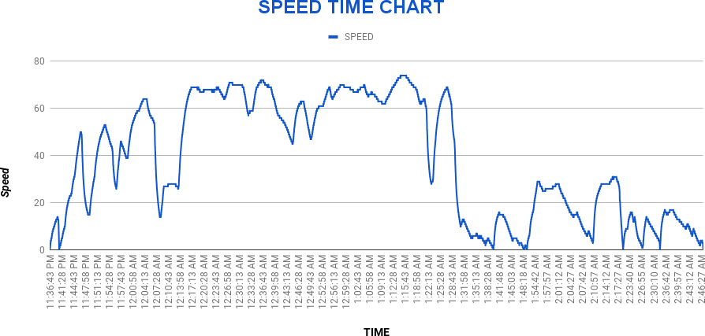
SPM Analysis
Indian Railways

Slide 23
CASE STUDY-7

Slide 24
SPEEDOMETER DATA ANALYSIS-7
Journey Date: 02.12.24
LP Name/Desig:
Train No. 22846 (CHG)
Remarks:
Report ID: 031224/17168
ALP Name:
Loco Number: 22252/TKD
Section: LDH-NDLS MEDHA
MPS attained: 113 kmph | Average Speed: 59.79 kmph
Total Distance: 329.47 km | Total Time: 5:30:37
Distance covered at near MPS: 210.06 km (speed>.95xMPS) | Time Range of Analysis: 6:09:18 PM - 11:40:01 PM
Late Controlling: YES Over Speeding: NO Improper BPT: NO | Abrupt Braking: YES Poor Running: NO SR Overspeed: NO
BPT @ 6:25:41 PM | SPEED DROP: 63 - 32 | BFT @ 6:10:09 PM | SPEED DROP: 7 - 5
SPEED WHILE APPROACHING STOP SIGNAL AT DANGER
SGNL | TIME/KM NO | SPEED B4 1000mtr | SPEED B4 500mtr | SPEED B4 100mtr | SPEED B4 10mtr | Speed at Controlling/ Braking Distance | BRAKING Technique
-- | 7:00:49 PM | 48 | 46 | 16 | 5 | 108kmph / 2.582 km | Late
-- | 7:07:17 PM | 13 | 13 | 14 | 11 | 22kmph / 0.804 km | Late
-- | 7:27:40 PM | 30 | 28 | 25 | 14 | 109kmph / 2.893 km | Late
-- | 7:54:06 PM | 40 | 30 | 20 | 11 | 46kmph / 1.145 km | Late
-- | 8:10:46 PM | 29 | 27 | 23 | 13 | 108kmph / 5.411 km | Late
-- | 8:26:17 PM | 48 | 29 | 28 | 14 | 110kmph / 4.644 km | Late
-- | 8:50:57 PM | 10 | 9 | 25 | 16 | 25kmph / 0.137 km | Abrupt
-- | 9:15:27 PM | 50 | 48 | 19 | 11 | 51kmph / 1.159 km | Late
-- | 9:58:00 PM | 40 | 27 | 20 | 10 | 53kmph / 1.636 km | Smooth
-- | 10:28:03 PM | 47 | 46 | 26 | 13 | 108kmph / 3.461 km | Late
-- | 10:43:19 PM | 49 | 46 | 18 | 14 | 62kmph / 2.373 km | Late
-- | 10:55:49 PM | 43 | 14 | 13 | 10 | 44kmph / 1.383 km | Late

Slide 25

LP PERFORMANCE REPORT
-- | 11:12:48 PM | 46 | 35 | 19 | 6 | 70kmph / 4.825 km | Late
-- | 11:18:37 PM | 12 | 14 | 12 | 6 | 14kmph / 0.944 km | Smooth
-- | 11:28:22 PM | 9 | 13 | 8 | 3 | 16kmph / 0.693 km | Smooth
-- | 11:40:03 PM | 14 | 13 | 12 | 7 | -- | --
SPEED RESTRICTIONS OBSERVED BY THE LP
Section | SR Specified Speed | START FROM | END AT | AVG Speed Observed | Distance Travelled
-- | -- | -- | -- | ** | **
speed graph analysis of train no-22846exp. and loco no. 22252/TKD between LDH-NDLS
late controlling=11(all times speed less than 50kmph so these cases are not late controlling cases)
over speed=NO
improper BPT=NO
Abrupt braking=1(at time 8.50.57PM loco pilot observed ER 10 kmph in NRW yard and again stopped at NRW station in loop line as sch. stopage so not Abrupt braking case.
Poor running=NO
Report checked by
B.K.Gupta/CLI(DLI

Slide 26
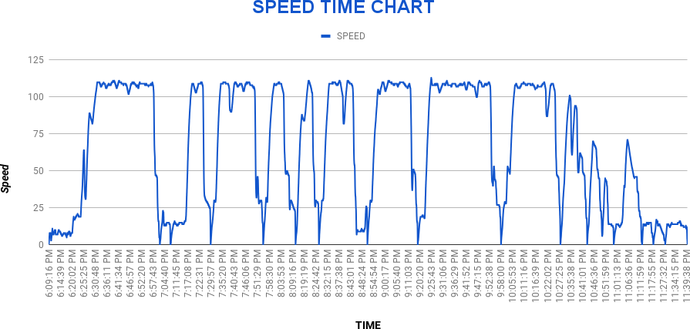
Indian Railways
SPM Analysis

Slide 27
CASE STUDY-8

Slide 28
SPEEDOMETER DATA ANALYSIS-8
Journey Date: 15.12.24
LP Name/Desig:
Train No. FN-SSB (GOODS/L (CONV))
Remarks:
Report ID: 161224/06148
ALP Name:
Loco Number: 28726/VTA
Section: GHH-SSB TELPRO
MPS attained: 76 kmph | Average Speed: 17.51 kmph
Total Distance: 61.83 km | Total Time: 3:31:49
Distance covered at near MPS: 10.39 km (speed>.95xMPS) | Time Range of Analysis: 9:32:16 AM - 1:04:11 PM
Late Controlling: YES Over Speeding: NO Improper BPT: YES | Abrupt Braking: NO Poor Running: NO SR Overspeed: NO
BPT @ 9:36:38 AM | SPEED DROP: 48 - 34 | BFT @ 9:33:34 AM | SPEED DROP: 10 - 9
SPEED WHILE APPROACHING STOP SIGNAL AT DANGER
SGNL | TIME/KM NO | SPEED B4 1000mtr | SPEED B4 500mtr | SPEED B4 100mtr | SPEED B4 10mtr | Speed at Controlling/ Braking Distance | BRAKING Technique
-- | 9:49:04 AM | 29 | 30 | 13 | 4 | 67kmph / 2.015 km | Smooth
-- | 9:56:27 AM | 25 | 11 | 8 | 6 | 13kmph / 0.441 km | Smooth
-- | 12:24:47 PM | 24 | 20 | 14 | 6 | 31kmph / 2.748 km | Smooth
-- | 12:40:07 PM | 18 | 23 | 21 | 12 | 18kmph / 0.971 km | Late
-- | 12:43:01 PM | 22 | 21 | 14 | 10 | 9kmph / 0.307 km | Smooth
-- | 1:04:15 PM | 9 | 8 | 9 | 6 | 18kmph / 1.762 km | Smooth
SPEED RESTRICTIONS OBSERVED BY THE LP
Section | SR Specified Speed | START FROM | END AT | AVG Speed Observed | Distance Travelled
-- | -- | -- | -- | ** | **

Slide 29

Speed graph analysis of train no.FN-SSB load and loco no. 28726/VTA between FN-SSB and observation following points.
late concontrolling =01( but speed less than 50 kmph)
over speed=NO
improper BPT=Yes (loco pilot has connected BPT but the speed dropped from 48kmph to 32kmph whereas as per rules he was supposed to reduce his speed to almost half.
Abrupt braking=NO
Poor running=NO
Counselled staff regarding conduct brake power testing
Report checked by
B.K.Gupta/CLI/DLI

Slide 30
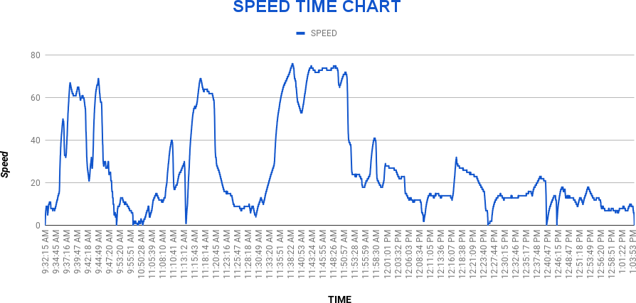
Indian Railways
SPM Analysis

Slide 31
CASE STUDY-9

Slide 32
SPEEDOMETER DATA ANALYSIS -9
Journey Date: 13.12.24
Report ID: 131224/14183
ALP Name:
LP Name/Desig:
Train No. BCN (GOODS/L (CONV))
Remarks:
Loco Number: 43004/VTA
Section: GZB-SSB MEDHA
MPS attained: 44 kmph | Average Speed: 12.58 kmph
Total Distance: 32.94 km | Total Time: 2:37:05
Distance covered at near MPS: -- (speed>.95xMPS) | Time Range of Analysis: 4:06:19 AM - 6:43:21 AM
Late Controlling: NO Over Speeding: NO Improper BPT: NO | Abrupt Braking: NO Poor Running: -- SR Overspeed: NO
BPT @ 4:46:25 AM | SPEED DROP: 26 - 16 | BFT @ 4:07:38 AM | SPEED DROP: 6 - 1
SPEED WHILE APPROACHING STOP SIGNAL AT DANGER
SGNL | TIME/KM NO | SPEED B4 1000mtr | SPEED B4 500mtr | SPEED B4 100mtr | SPEED B4 10mtr | Speed at Controlling/ Braking Distance | BRAKING Technique
-- | 4:08:16 AM | -- | -- | 6 | 5 | 6kmph / 0.094 km | Smooth
-- | 4:23:55 AM | 13 | 13 | 4 | 3 | 12kmph / 1.265 km | Smooth
-- | 4:31:22 AM | 13 | 3 | 9 | 5 | 12kmph / 1.696 km | Smooth
-- | 5:42:26 AM | 17 | 16 | 8 | 5 | 40kmph / 2.21 km | Smooth
-- | 6:03:15 AM | 21 | 10 | 5 | 3 | 27kmph / 2.683 km | Smooth
-- | 6:42:28 AM | 15 | 15 | 6 | 4 | 19kmph / 3.062 km | Smooth
SPEED RESTRICTIONS OBSERVED BY THE LP
Section | SR Specified Speed | START FROM | END AT | AVG Speed Observed | Distance Travelled
-- | -- | -- | -- | ** | **

Slide 33
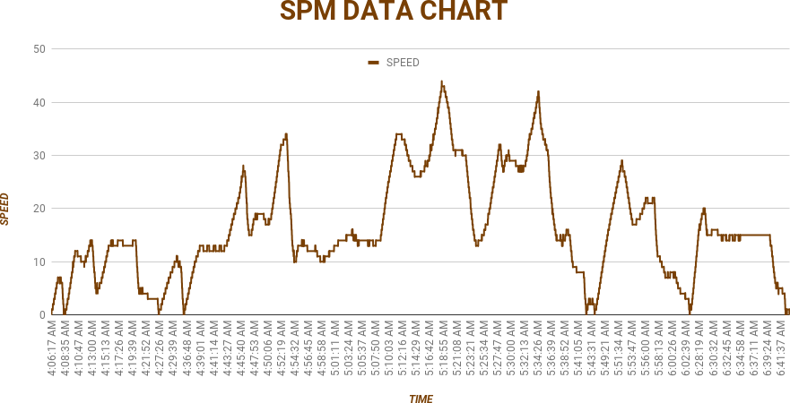
NO deficiency found ✔
Late Controlling: NO
Over Speeding: NO
Improper BPT: NO
Abrupt Braking: NO
Poor Running: -NO
SR Over speed: NO
Report checked by
Arun Kumar Sinha
CLI/ROK

Slide 34
CASE STUDY-10

Slide 35
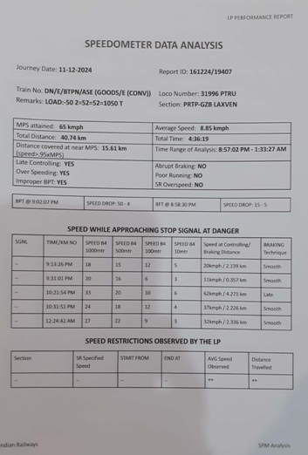

Slide 36
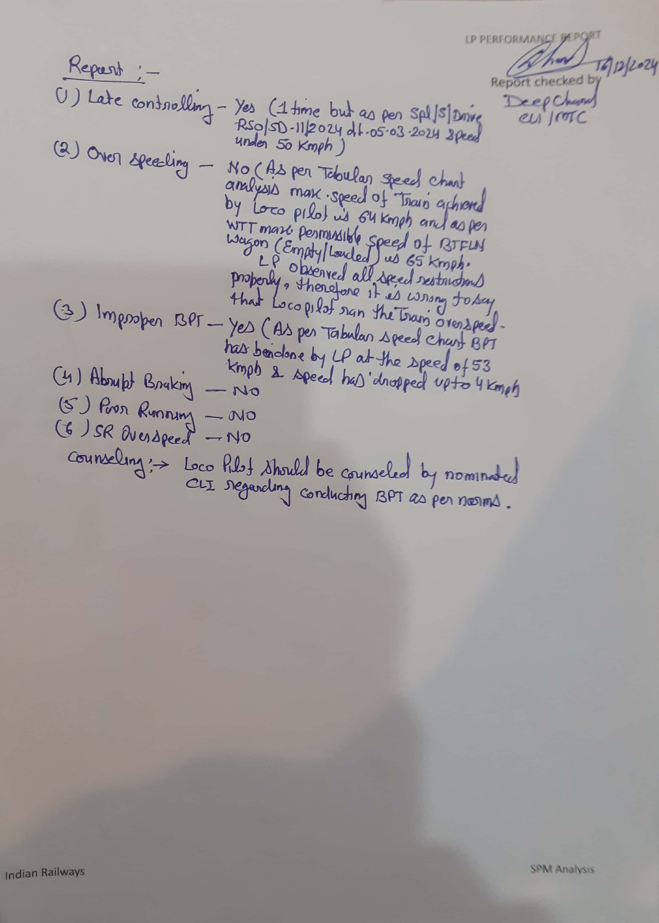

Slide 37
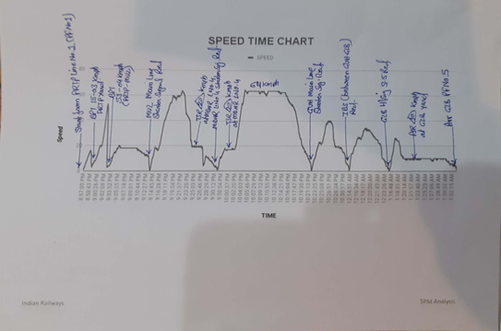

Slide 38
Summarization of SPM Data Analysis of DLI Division
 | DLI
1. Late Controlling | 35
2. Poor Running | 02
3. Improper BPT | 03
4.Abrupt Braking | 03
5. Over Speeding | 01
6. SR Over Speeding | Nil
विद्युत् प्रशिक्षण केंद्र, गाज़ियाबाद

Slide 39
निष्कर्ष
स्पीडोमीटर के Data Analysis के पश्चात् यह संज्ञान में आया है कि निम्न बिन्दुओ पर ध्यान देकर ड्राइविंग तकनीक में सुधर किया जा सकता है वह गाड़ियों का सुरक्षित संचालन किया जा सकता है स्पीडोमीटर डाटा के अनुसार निम्न लिखित बिन्दुओ पर ध्यान देना आवश्यक है |
1. LATE BRAKING :-
A) लोको पायलट को गाड़ी सञ्चालन के दौरान सिग्नल का संकेत एक पीला मिलने पर कोचिंग गाड़ी एवं खाली मालगाड़ी में गाड़ीकी गति अधिकतम 50 KMPH तथा भरी मालगाड़ी की गति 30 KMPH से अधिक नहीं होनी चाहिए।
B) लोको पायलट द्वारा गाड़ी की गति रुकने के स्थान से 10 METER पहले 10 KMPH से अधिक नहीं होनी चाहिए।

Slide 40
2) BPT & BFT:- ब्रेक पॉवर टेस्ट व ब्रेक फील टेस्ट करने की विधि :-
3) POOR RUNNING: लोको पायलट द्वारा गाडी का संचालन सेक्शनल स्पीड के अनुसार किया जाएगा, सभी प्रकार के गति प्रतिबन्धों का पालन करते हुए।
4) ओवर स्पीर्डिंग: किसी भी परिस्तिथि में ओवरस्पीडिंग नहीं किया जाएगा। अगर किसी कारणवश स्पीड अधिकतम स्पीड से 03 Kmph और 03 सेकंड से अधिक है तो इसे OVER SPEED माना जाएगा।
5) PSR व TSR: लोको पायलट द्वारा गति प्रतिबंध (PSR व TSR) का पालन कड़ाई से किया जाएगा एवं गति प्रतिवन्ध के पालन का तरीका GRADUALLY होना चाहिए गति प्रतिबन्ध बोर्ड के संकेत के अनुसार ।
6) ABRUPT BRAKING: गाड़ी संचालन के दौरान ब्रेकिंग GRADUALLY होनी चाहिए, PVEF का इस्तेमाल होना चाहिए ताकि WHEEL SKID से बचा जा सके। मगर किसी कारणवश अचानक ब्रेक लगाना पड़ता है तो लोको पायलट के संज्ञान में EMERGENCY BRAKING DISTANCE अवश्य होनी चाहिए।
BPT |  |  | BFT
विवरण | Coaching गाड़ी | मालगाड़ी | विवरण | Coaching गाड़ी | मालगाड़ी
गति | 60-70 KMPH | 30-50 KMPH | गति | 15 KMPH | 15 KMPH
प्रेशर ड्राप | 1 Kg/cm2 | 1 Kg/cm2 | प्रेशर ड्राप | 0.5 Kg/cm2 | 0.5 Kg/cm2
प्रेशर ड्राप होने के पश्चात गति | 30-35 KMPH | 15-25 KMPH | प्रेशर ड्राप होने के पश्चात गति | 5-10 KMPH | 5-10 KMPH

Slide 41
7) GRADUALLY BRAKING: लोको पायलट द्वारा BRAKE POWER TEST के अनुसार A-9 द्वारा आवश्यक BRAKING DISTANCE को ध्यान में रखते हुए BP प्रेशर गिराया जाएगा। गाड़ी कंट्रोल के पश्चात AIR FLOW INDICATOR का भी ध्यान रखना चाहिए | गाड़ी की स्पीड सिग्रल के संकेत के अनुसार होनी चाहिए । गाड़ी की CONTROLLING इस प्रकार होनी चाहिए कि EMERGENCY BRAKE का इस्तेमाल EMERGENCY में ही हो जैसे MRO, CRO, अचानक SIGNAL का ON हो जाना, गाड़ी में, OHE में या TRACK पर कोई अन्य अवरोध दिखाई देने या होने पर इत्यादि ।
NOTE:- धुंध व कोहरे के मौसम में बरती जाने वाली सावधानिया;
स्वचालित संचालन सिग्नलिंग प्रणाली में सामान्य मौसम में गाड़ियों का संचालन GR/SR-9.02
एवं GR /SR 9.15 का पालन किया जाएगा |
धुंध व कोहरे के मौसम में गाड़ियों का संचालन निम्न प्रकार किया जाएगा
a) यदि लोको में FSD उपलब्ध है तो स्वचालित सिग्नल हरी अवस्था में मिलने पर गाडी कि गति अधिकतम
75 KMPH होगी |
दो पीली ( DOUBLE YELLOW) अवस्था में मिलने पर गाड़ी कि गति अधिकतम 30 KMPH होगी :
एक पीला (SINGLE YELLOW ) अवस्था में मिलने पर गाडी को ऐसी प्रतिबंधित गति से चलाएगा
कि अगले स्टॉप सिग्नल पर रुकने के लिए तैयार रहेगा |
b) यदि लोको में FSD उपलब्ध नहीं है या रास्ते में खराब हो गयी है तो ऊपर बतायी गयी 75KMPH
कि अधिकतम गति को 60 KMPH या लोको पायलट के विवेकानुसार कम रखा जाएगा |

Slide 42
पूर्ण ब्लाक पद्धति में गाड़ियों का संचालन:-
A) डबल डिस्टेंट सिग्नल वाले सेक्शन में गाड़ियों कि गति FSD कार्यरत अवस्था में
होने पर अधिकतम 75KMPH होगी |
FSD कार्यरत अवस्था में न होने पर अधिकतम गति 60 KMPH या लोको पायलट
के विवेकानुसार कम रखा जाएगा |
B) सिंगल डिस्टेंट सिग्नल वाले सेक्शन में गाड़ियों कि गति FSD कार्यरत अवस्था में
होने पर अधिकतम 75KMPH होगी |
FSD कार्यरत अवस्था में न होने पर अधिकतम गति 50 KMPH से कम या
लोको पायलट के विवेकानुसार कम रखा जाएगा |
विद्युत् प्रशिक्षण केंद्र, गाज़ियाबाद

